Slide 1
Investigation:
Mini Project 1
Is there a difference in the quality of government provided schooling in Rural South Australia?
Matt Hacket

Slide 2
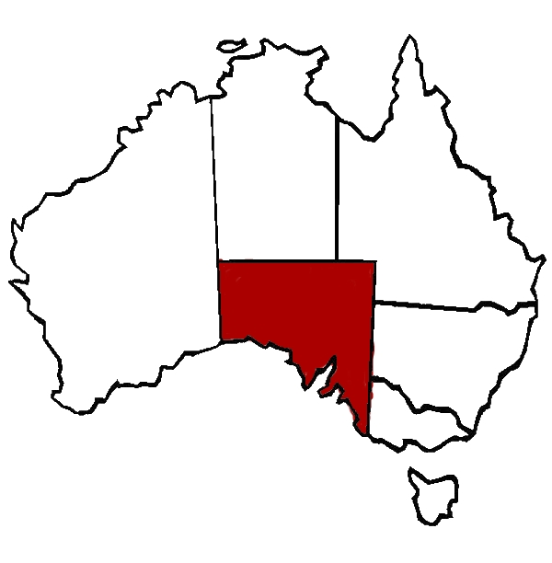
Background
South Australia is Australia’s 4th largest state by area; 5th largest state by population
77% of SA’s population live in the state capital, Adelaide and surrounds (population 1,345,777 [2018])
Second largest township: Mt Gambier – 29,639 (2018)
I am South Australian, with some of my family still living there…

Slide 3

What is my business question?

Slide 4
What is my business question?
Does the distance from Adelaide affect disadvantage levels of government provided education in South Australia?
(and therefore should they receive more funding?)

Slide 5
Data Pipeline
Data Exploration
Hypothesise
Business Question
Data Munging
Data Acquisition
Visualisation
Results

Slide 6

Dataset
Downloaded as a .csv
‘index-of-disadvantage-by-school-2020.csv’
Data was already clean – 0 null
Past years also available – 2020 chosen

Slide 7
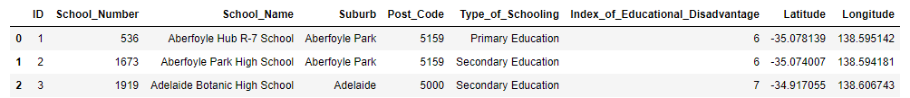
Dataset
df.head(3)
512 Schools
School number, school name
Suburb, post code
School type
primary, secondary and special schools

Slide 8
Features of Interest
df.head(3)
Index of Educational Disadvantage
Surrogate for ‘quality’
Location
Columns for latitude and longitude
Question?
Does the distance from Adelaide affect disadvantage levels of government provided education in South Australia?

Slide 9
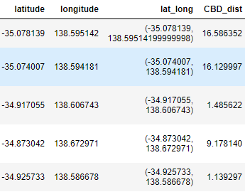
Calculating Distance
Used Python library GeoPy to calculate distance using geodesics
Transformed latitude/longitude columns into single column for use in GeoPy formula

Slide 10
Index of Educational Disadvantage
Values reflect disadvantage where:
1: Most disadvantaged
7: Least disadvantaged

Slide 11
Hypothesis
H₀: There is no difference in the index of disadvantage for metropolitan and rural schools in South Australia
H₁: There is a statistical difference in the index of disadvantage for metropolitan and rural schools in South Australia

Slide 12
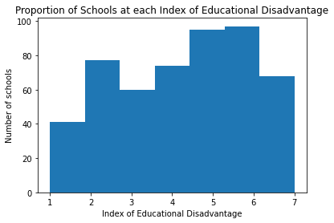
Visualisation
Distribution of index of educational disadvantage
1: Most disadvantaged
7: Least disadvantaged

Slide 13

Visualisation
Distribution of index of educational disadvantage
Mean = 4.30
Skew = - 0.22

Slide 14
Metropolitan / Rural Schools
Decision to make cut-off for Metro limits 30km – ‘evenly split’ the data
 | All Schools | Metro | Rural
Schools | 512 | 258 | 254
Mean | 4.30 | 4.67 | 3.94
SD | 1.87 | 1.91 | 1.76
7, 6 | 68, 97 | 55, 56 | 13, 41
2, 1 | 77, 41 | 41, 11 | 36, 30

Slide 15
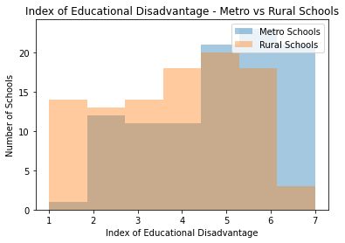
Results
- Took population samples of both metro (<30km) and rural (>30km); n = 100

Slide 16
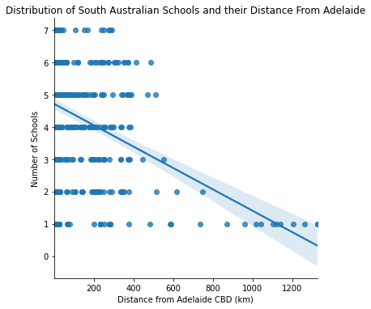
Visualising Distance vs Score

Slide 17
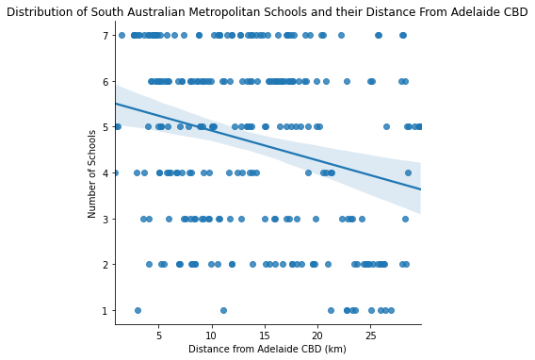
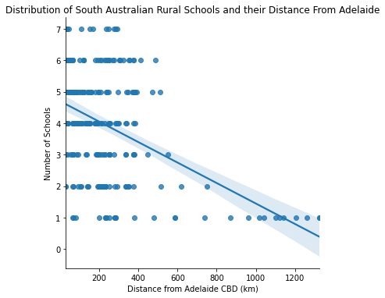
Visualising Distance vs Score
Metro Sample Rural Sample

Slide 18
Hypothesis Testing
Remembering:
H₀: There is no difference in the index of disadvantage for metropolitan and rural schools in South Australia
H₁: There is a statistical difference in the index of disadvantage for metropolitan and rural schools in South Australia

Slide 19

Hypothesis Testing
CONCLUSION:
p = 0.0000142 is < 0.05
Evidence in favour of the alternative hypothesis
H₁: There is a statistical difference in the index of disadvantage for rural schools in South Australia compared to metropolitan schools
(therefore, there should be a consideration for an increase in funding for rural schools)

Slide 20
Further Investigations
Compare against previous years
Median income for each school’s postcode
Index of disadvantage per enrolled school child/class number
Breakdown of school types – primary/secondary and effect of distance on quality i.e are rural primary schools at a lower disadvantage than rural high schools (or vice versa?)

Slide 21
References
https://kanoki.org/2019/02/14/how-to-find-distance-between-two-points-based-on-latitude-and-longitude-using-python-and-sql/
https://data.sa.gov.au/data/dataset/index-of-disadvantage-by-school
https://data.gov.au/data/dataset/taxation-statistics-postcode-data
https://en.wikipedia.org/wiki/South_Australia

